Slide 1
From Solano County, California to Social Impact Measurement (ICSIM)
Framework and Tools

Slide 2
Solano County Public Health Data Hub

Slide 3
Solano County – California Wildfires 2017
Most impacted with the fewest resources are the displaced, homeless, veteran, vulnerable and underserved populations
• Situation awareness was complicated by a lack of data sharing across government, non-profit, organizational and response organizations
• Reliable and resilient “basic” communications capabilities needed, especially for medical response, data gathering and sharing
• Continuously updated “Needs Assessments” for individuals during Response efforts needed
• “ad-hoc” assessment questions needed to adapt to the unique needs and evolve over time during the Recovery-Rebuild-Resilience phases

Slide 4
County Level Population Health Analytics - 2018

Slide 5
Federal Health Futures – 2009-2013

Slide 6
How to measure and compare Social Impact Projects?
How much impact each one of the projects has had and how does that compare to others
We lack
a unified framework that connects standards efforts in a diverse, fragmented, and silo’d Impact landscape
a common language to answer this question consistently and universally
ways to learn from earlier projects and avoid common mistakes

Slide 7
Impact Management Project 2018-2019
After hundreds of in-person and virtual conversations, the Impact Management Project a Practitioner Community of over 2,000 organizations, reached consensus that impact can be deconstructed into five dimensions:
What tells us what outcomes the enterprise is contributing to and how important the outcomes are to stakeholders.
Who tells us which stakeholders are experiencing the outcome and how underserved they were prior to the enterprise’s effect.
How Much tells us how many stakeholders experienced the outcome, what degree of change they experienced, and how long they experienced the outcome for.
Contribution tells us whether an enterprise’s and/or investor’s efforts resulted in outcomes that were likely better than what would have occurred otherwise.
Risk tells us the likelihood that impact will be different than expected.

Slide 8
Social Impact Measurement Challenges
No common metrics to compare outcomes of different initiatives
No ongoing visibility into progress of current projects
No way to forecast which projects are likeliest to result in positive social impact
No shared learning for project doers to avoid failure
Needed by all parties interested in the resulting social benefit of capital investments include investors of all kinds including governments – federal, state, local, city, corporations, lenders like the World Bank and UN agencies, researchers, social scientists, financiers, economists, foundations, NGO's, and grantors.

Slide 10
Desired Social Impact Measurement Outcomes
More efficiently direct investment and Funding
Avoid "Green Washing"
Boost collaboration / synergy
Quantify Social Return on Investment
Prioritize Human Well-being
Preserve the PEOPLE AND THE Planet
$

Slide 11
Open Source repositories of Tools under consideration for Social Impact Measurement
Naming convention to uniquely identify data sources
Income, demographics:
past & forecast
Curated repository of Formulae, Logic Models
Measurement formulae, logic models, processes
Data usage principles
Culturally appropriate
Context sensitive use

Slide 12
Data sources could contain
basic demographic data
forecasts and projections
Potential Data Sources
World Bank, UN, IMF
Reputable research institutions,
Government sources
Accredited academic institutions
Naming convention to be developed
Unique data source identification
Data user identification
Data source reliability

Slide 13
Collected measurement calculations, logic models, processes and methods for calculating how project outputs transform into social outcomes
People at the grassroots community level, schools, and investors, grantors, the UN, the World Bank, the IMF, grantors and more will be
Able to learn from earlier research and project outputs and outcomes
Aware of each other’s different perspectives on formulae applicability
Able to compare actual outcomes against formulae used
Able to combine learnings from first-hand efforts, global research, or earlier investments

Slide 14
Principles for culturally appropriate and context sensitive data and formula use including race, income, ability/disability, age, religion, language, sexual orientation, tribal affiliation, national or regional geographic, etc.
Developed case-by-case for projects in specific communities
IEEE becomes universal source for principles which might differ within different communities

Slide 15
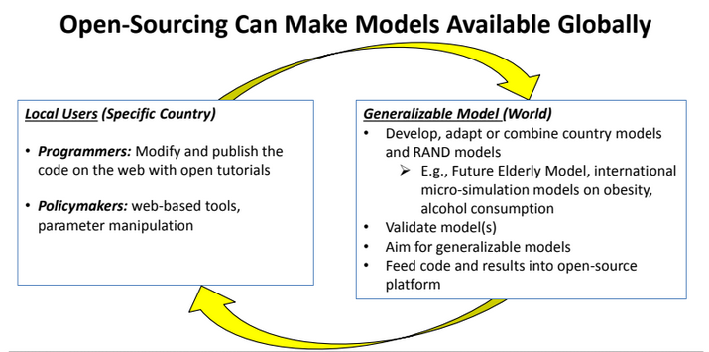
RAND CORPORATION
Open Source repositories ala’ GitHub can assist collaboration between the social impact platforms and benefit those who develop, operate and invest in social impact projects

Slide 16
Population
Level
Interventions
Concept: KB Tan,
Mei Lin Fung
Prof. Debbie Freund
Health Economist

Slide 17
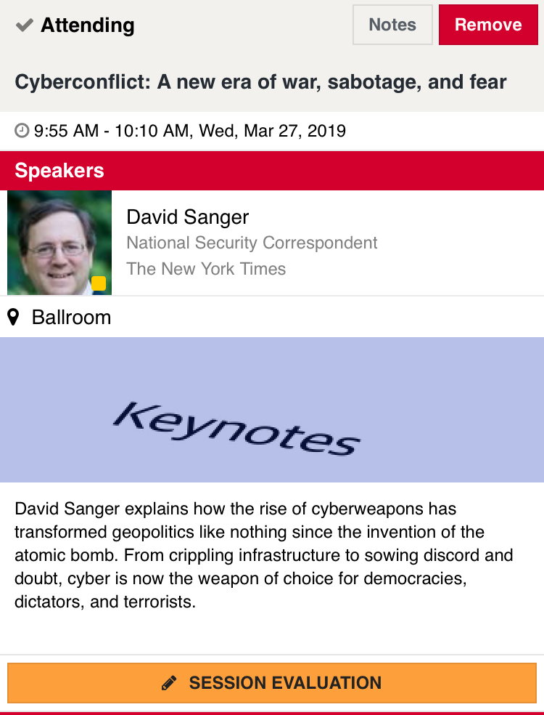
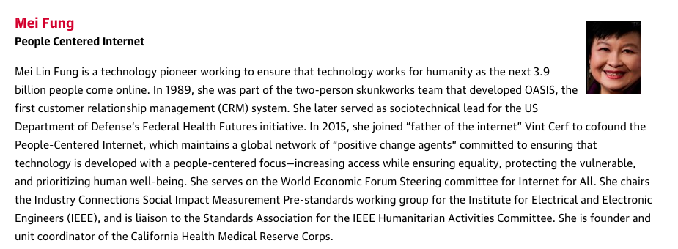
Rate today ’s session
Session page on conference website
O’Reilly Events App

